Slide 1
Housr Wallet
Create a wallet and the more they spend from the wallet the more tiers they can unlock
Higher tiers have better benefits

Slide 2
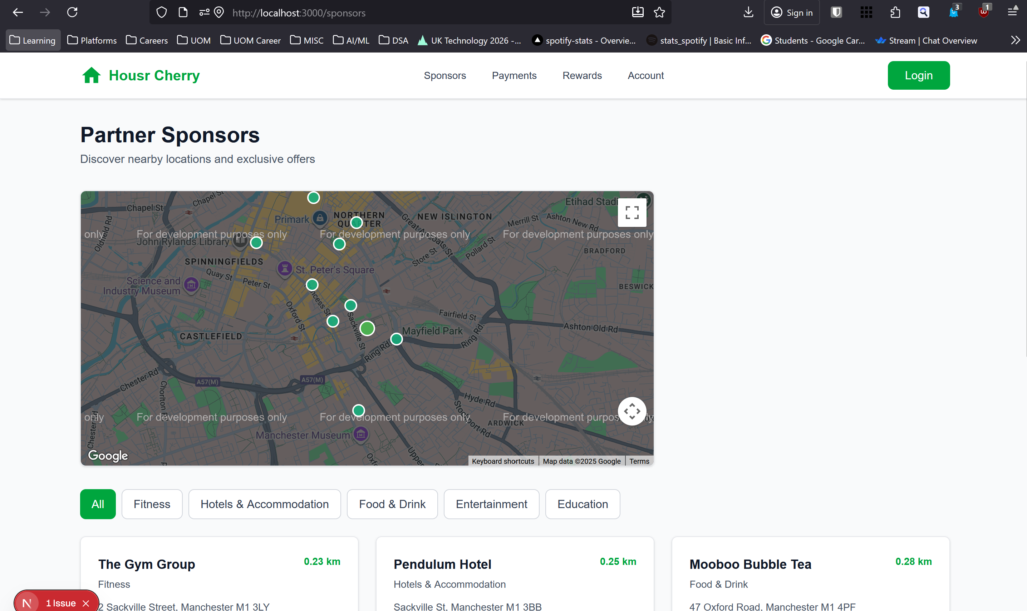

Slide 3
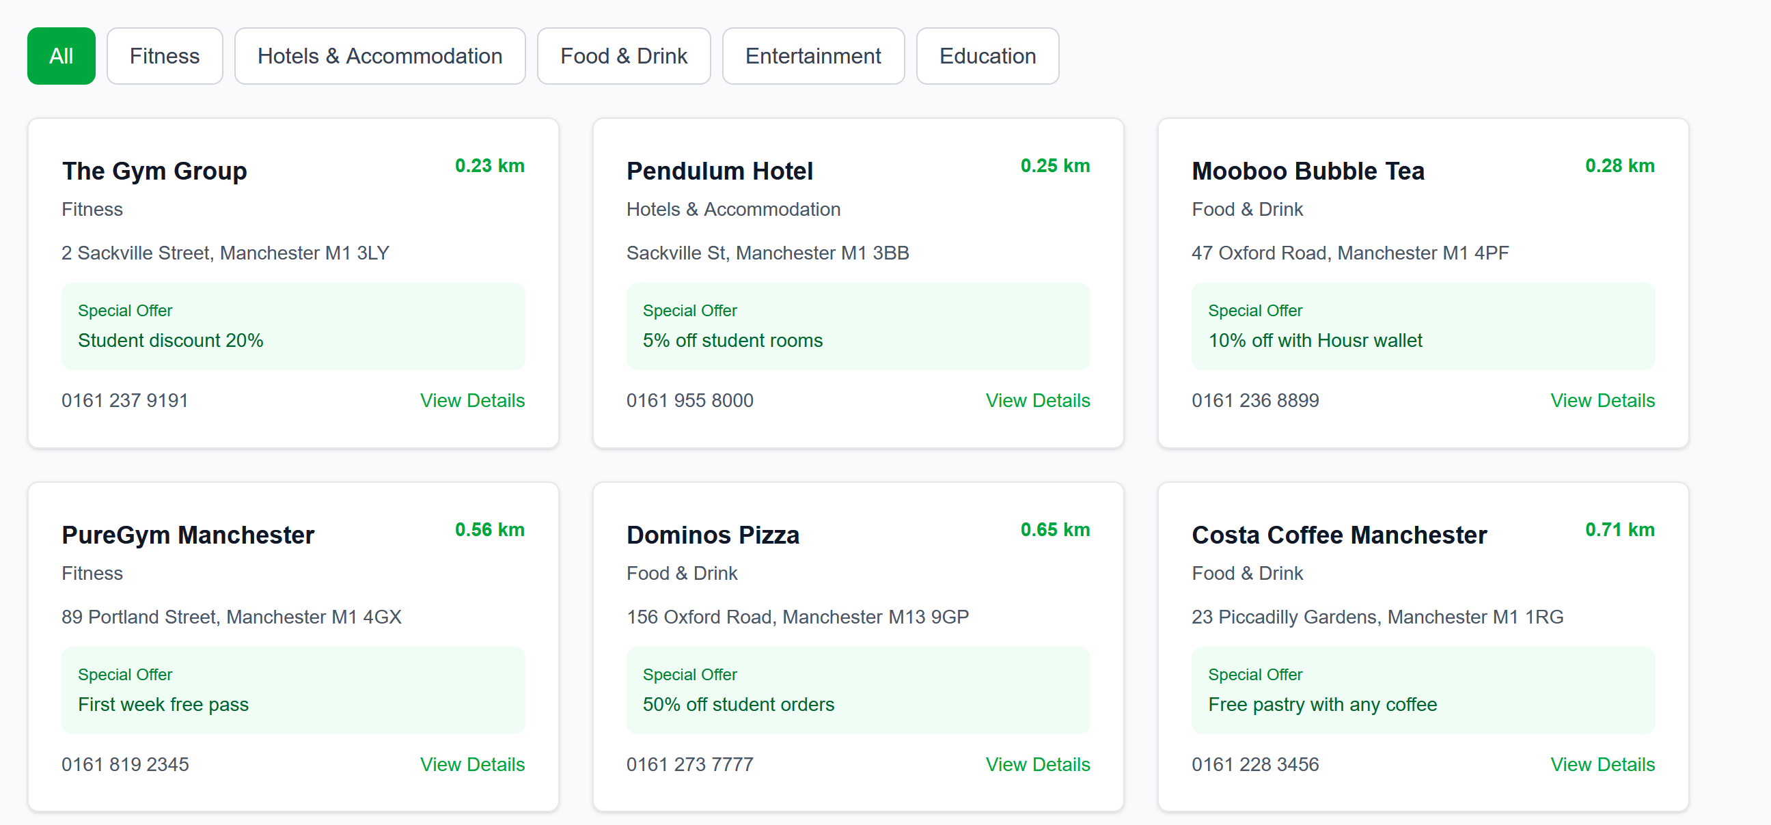

Slide 4
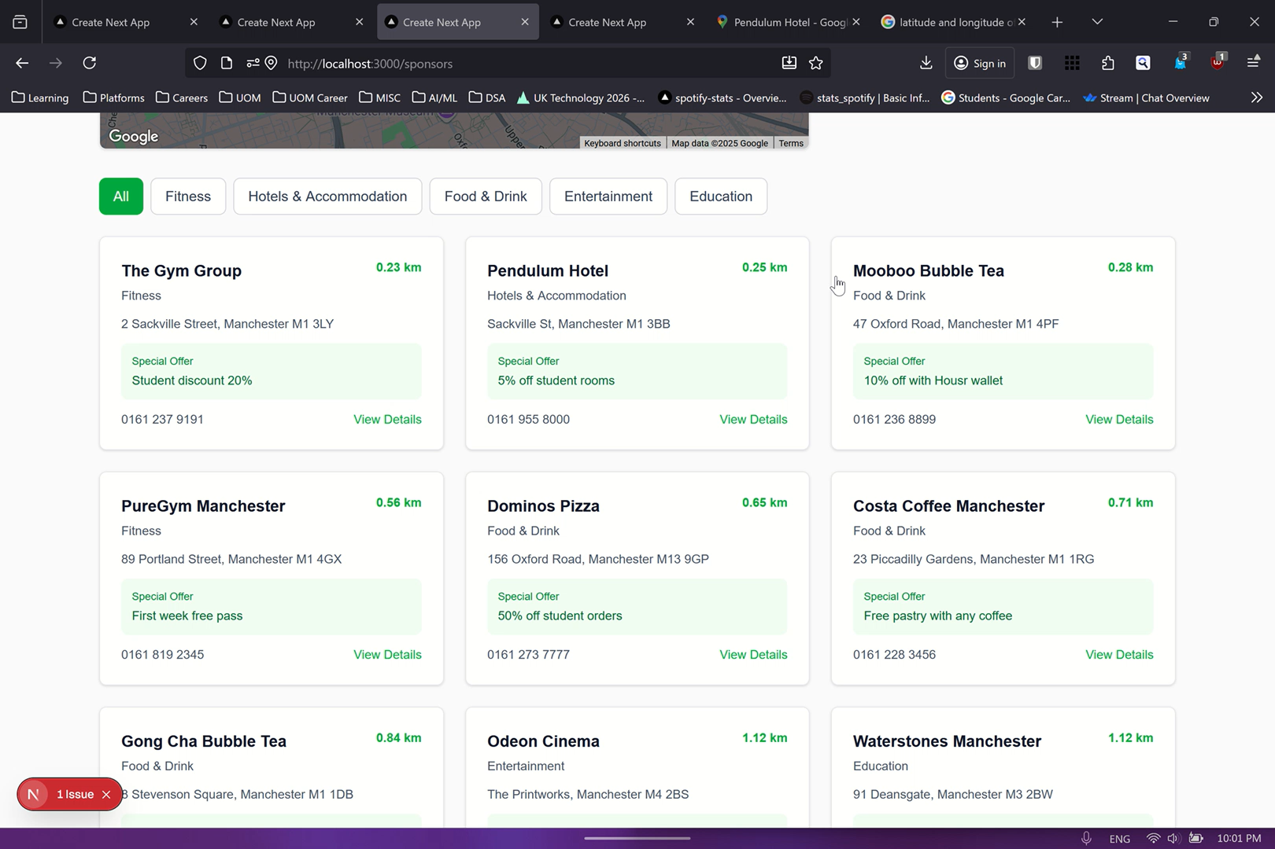

Slide 5
Future Plans
We could create a sponsor interface for Housr Cherry
So in moments of low traffic businesses can send out offers and deals
Instantly notify Housr Cherry student users about new offers and deals to increase foot traffic in business/restaurant

